Slide 1


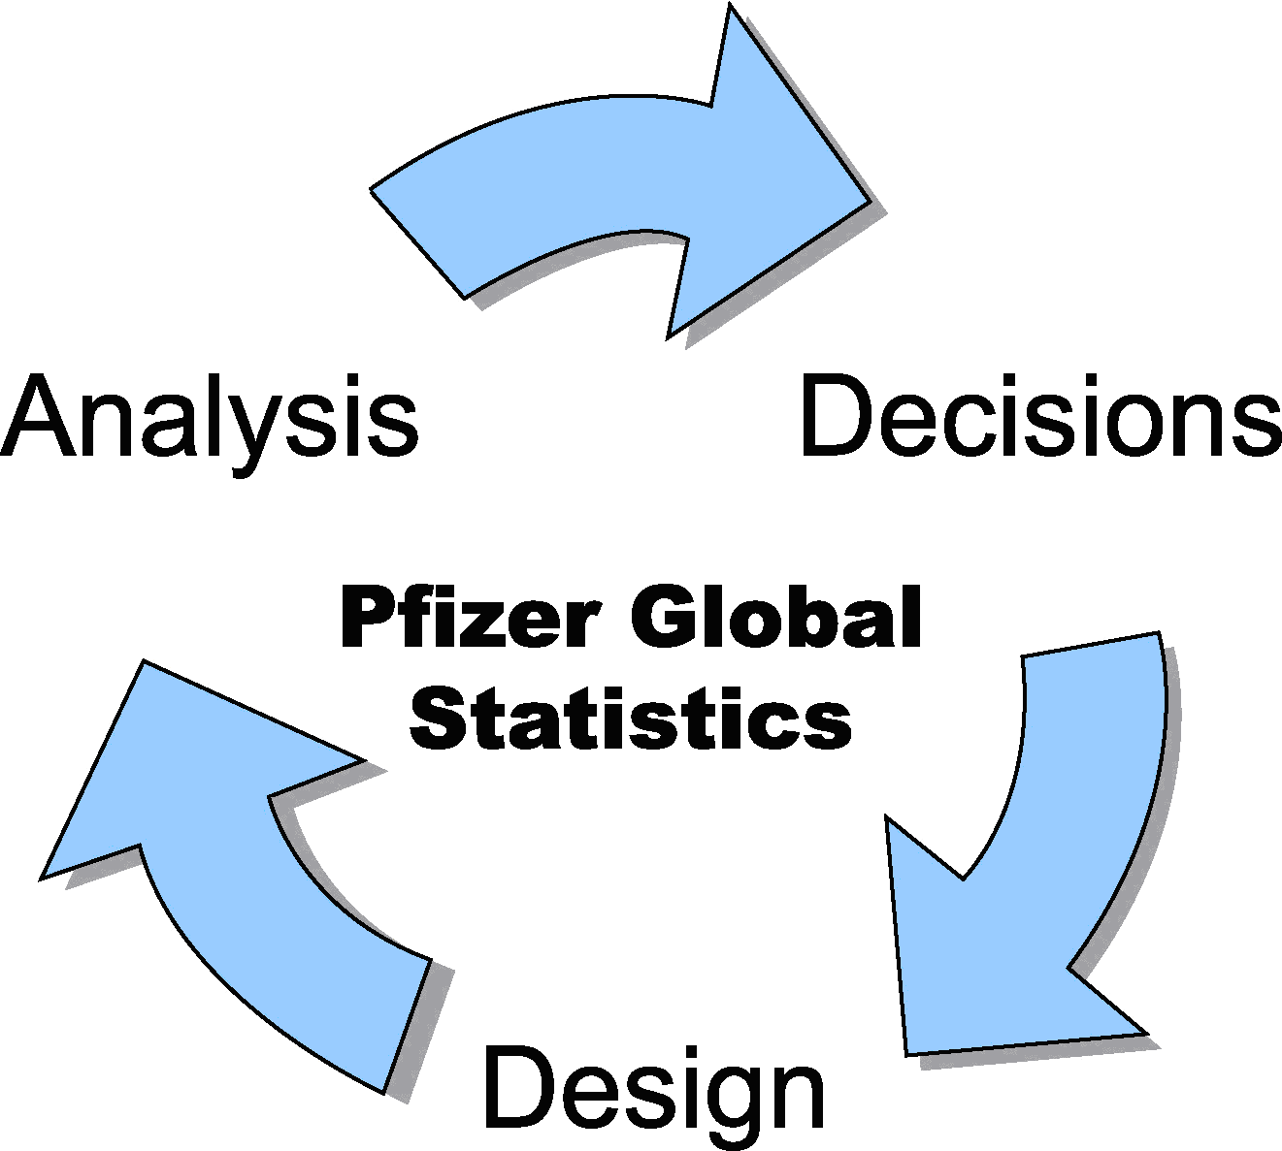

Phil Woodward (Pfizer)
Royal Statistical Society
Guy Lecturer 2008
Experimental Design
How statisticians influence
research & development
Notes:
Pfizer: cholesterol, pain relief, lung disease, virus (AIDS), cancer, viagra; will not be talking anymore about Pfizer, will talk about …
The important role statisticians, or people with statistical skills, have in the R&D of new products – not just new medicines – and in particular their role in the design of experiments
Stained glass window on right – college in Cambridge Uni – celebrate life of one of greatest statisticians, Fisher, who played major role in development of statistical methods, particularly experimental design
Anybody recognise the pattern INTERACT – only if had chance to do the puzzles – will come back to the relevance of this pattern later

Slide 2
What will I be talking about?
Experimental design
  What is it all about?
Why are statisticians so important?
  We have skills that others need!
How statistical methods are widely used.
  Across disparate application areas
But, isn’t statistics really boring?
  Not if you like science or problem solving or working in teams or creating new stuff …
Notes:
Why is experimental design important, and how having the ability to solve the types of puzzle I gave out can help in designing experiments
Explain some of the statistical skills that are so valuable
Show that these methods are not just used in the R&D of new medicines – first 10 years I worked in engineering industry – same skills used now
And want to show that being a statistician is a lot more than just being a number cruncher
So a lot to cover, and not a lot of time left to do it, so I’d better crack on …

Slide 3
How good is Medicine X?
X
Much worse
No better
Much better
Can we conclude that the new medicine works?
What questions might you want to ask?
Notes:
I want you to imagine you are responsible for analysing a clinical trial, i.e an experiment to test a new medicine
Suppose we treated one patient with the new medicine and after 4 weeks she reported, on this sophisticated measuring scale, that she was “a bit better”
An aside – the scale is not so different to some we actually use – imagine trying to report how much pain you were feeling …
BUILD QUESTIONS & INTERACT
Most (all!) will not think we have enough info – past first test of being a statistician – scepticism of new evidence – give eg VERY rare case when this might be enough – previous 100% fatal disease
More generally only some newspapers believe that the experience of a single individual is enough evidence to publish
So what other questions might you ask? INTERACT
Well there are numerous questions – why this patient, do we know the measurement process will differentiate between good & bad medicines, is 4 weeks long enough, …
It is this part of the job that makes being a statistician so interesting; we need to understand the context of the study in order to be able to help design it – we need to be able to discuss, at a reasonable level, the scientific or technological issues
So must ask lots of questions, with the purpose of helping to determine the objectives of the study and ensuring that it is designed to be able to meet these objectives.
But I want to focus on one particular question that is probably the most clearly statistical in nature
What would happen if we gave the medicine to another patient? That is, how repeatable is the effect of the medicine?
If it was similar, then start to get a warm feeling, if very different, particularly if worse, then not so confident.

Slide 4
How good is Medicine X?
We must test the medicine on more than one patient.
But how many patients do we need?
X
X
X
X
X
X
X
X
X
X
X
X
X
X
X
X
X
X
X
X
X
X
X
X
X
X
X
Much worse
No better
Much better
Can we stop now?!
Notes:
After each result ask class to raise hand (& keep it raised) when they think we have enough evidence that the medicine works. INTERACT
If anyone still not convinced at the end, then ask, Why?
Ask someone who put their hand up early why they were convinced.
Ditto someone later.
This illustrates that different people can look at the same data and come to different conclusions.
We would like an objective way of deciding whether the medicine was working, i.e. a way that most people would agree with and gave the same answer no matter who did the analysis.
This is one thing that the science of statistics brings to new product development.
Can anyone spot a flaw in this study in which all patients are given a new medicine? INTERACT
How do we know that they would not have got better anyway without treatment? We cannot logically conclude that the medicine caused the patients to get better.
Also, anyone heard of the “Placebo effect”? : physical improvement because psychologically we think we should be getting better.
We need to compare the change in wellness after giving the medicine with what would have happened if the patient had not been treated at all, but allowing for any potential placebo effect.

Slide 5
How good is Medicine X?
Treated patients
Placebo patients
Much worse
No better
Much better
Medicine works, but is the improvement enough?
Did we need to include this many patients in the study?
Notes:
Common way of running such a study is to allocate half the patients to the new medicine and half to a placebo treatment
(pill with no active ingredient in, made to look the same as the real pill)
Although the two groups overlap, there certainly appears to be evidence that the medicine is having some effect
People get more “well” on average.
But it requires a proper statistical analysis to reliably quantify the size of the treatment effect, so that a decision
can be made as to whether this is large enough to justify the cost & any potential side effects.
But did we need to include this many patients?
It is usually important to include as few patients as possible to reliably test the medicine in a clinical trial – ethical, cost and speed of getting new medicines to patients.
Statisticians have skills that help in determining this number.
Other than the costs, there are 2 attributes of the study data that have a large influence on how many patients are required.
One is how much variability in the distributions shown here – if the placebo results (red blobs) were more tightly packed together, and similar for the green blobs, these distributions would be more clearly separated.
SWITCH BACK & FORTH BETWEEN THIS & NEXT SLIDE TO EXPLAIN THE POINT

Slide 6
How good is Medicine X?
Treated patients
Placebo patients
Much worse
No better
Much better
With less variation, need fewer patients
for same size of treatment effect
Notes:
Because there is less variation we do not need so many results to be able to see that these distributions are separated from each other, and hence that the medicine is having some effect
SWITCH BETWEEN THIS & NEXT SLIDE
The other attribute that is important is the size of the effect of the medicine – a larger effect makes it even easier to see the difference, hence even fewer patients are needed

Slide 7
How good is Medicine X?
Treated patients
Placebo patients
Much worse
No better
Much better
And if the effect size is larger …
… need even fewer patients
Notes:
Knowledge of statistics is needed to allow these issues to be formally assessed and an appropriate sample size determined
Note that the size of the experiment required depends upon information we don’t know in advance of running the experiment
- how much variation occurs & how big is the treatment effect
This makes sample sizing very difficult – need to help scientists identify likely values for these
Review published literature, previous studies or obtain “expert judgement”

Slide 8
How good is Medicine X?
Suppose experiment has been designed
Does it matter how we decide which patients receive placebo or the medicine?
In 1988 Nature published an experiment purporting to show that homeopathy works
  experiment was re-run, this time “statistically”
  results were not repeated
  lack of randomisation was a likely problem
Notes:
Ask for students opinions and reasons. INTERACT
Sources of bias
medics might assign the sicker patients to medicine
if all the patients in the UK were given placebo, and all the patients in China were given medicine,
any differences in the 2 populations will be “confounded” (unable to separate these differences from effect of treatment)
more generally, a sceptical reviewer of the results of the study could suggest that the experimenter chose a method to bias the results in his favour
Randomisation is a statistical technique to reduce the effect of any potential biases, and safeguard the experimenter from accusations of “cheating”
More on Homeopathy experiment in Significance 2005 (v2 issue 3)

Slide 9
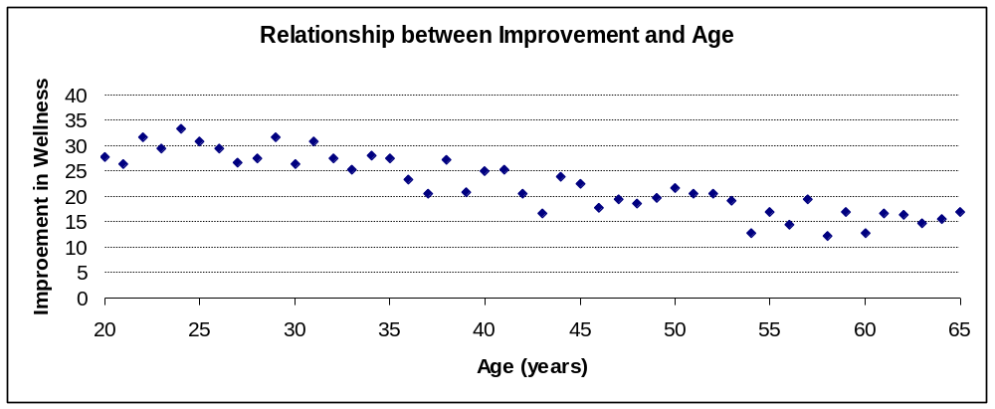
How good is Medicine X?
What if we thought males and females naturally got better at different rates?
Or that younger people got better quicker than older people?
Improvement
Notes:
Why is this a problem?
The variation caused by the different ages of the patients will increase the variation in our improvement measure
As already discussed, more variability means we need to run a bigger study
Variation is THE major problem in obtaining information from experiments or any type of study
Any ideas on how we could overcome this problem? INTERACT
Could use the randomisation technique to reduce any bias, but the variation will still be increased, leading to the need to run a bigger study
Can use a statistical analysis technique known as REGRESSION – effectively fits a line to the data & instead of analysing the actual improvement recorded, we analyse an “age adjusted” improvement
Eg 20 would be a low score for someone age 20 but a high score for someone aged 65.
A much better way to deal with this problem is to design the study so that the effects of these “nuisance factors” are eliminated at source.
The statistical technique known as BLOCKING is used to do this as I will now illustrate by example.

Slide 10
BLOCKING
Are the new shoes any better?
New
o
o
o
o
o
o
o
o
o
o
o
Old
o
o
o
o
o
o
o
o
o
o
o
Badly Worn Some Wear Perfect
Wear & Tear
No evidence of a difference between the 2 types of shoe.
But could we have designed this experiment better?
Notes:
Suppose you are the manufacturer of children’s shoes & a new supplier of shoe soles comes to you claiming their product is longer lasting. You decide to run an experiment to test the new supplier’s claim.
You make some shoes with “old type” soles and some with the new soles and give them to some children to test out. Half the children in the study will wear the old style shoes and the other half will wear the new shoe type. After 4 weeks you take the shoes back and measure how much they have worn out.
BUILD GRAPH
Who thinks that this data provides strong evidence that the new soles are better than the old soles?
If any say “Yes” then ask why.
BUILD ANALYSIS CONCLUSION
State that a formal statistical analysis of this data will not show any evidence of a difference, so you send the new supplier away with a “Thanks, but no thanks reply”.
Can anyone think of a better way to design this experiment?

Slide 11
BLOCKING
Are the new shoes any better?
O
o
Old
New
N
o
O
O
o
o
N
N
o
o
O
O
o
o
N
O
o
o
O
N
N
o
o
Wear & Tear
Wear & Tear
o
O
O
o
N
o
o
N
O
o
N
N
o
o
o
O
o
N
o
No evidence of a difference between the 2 types of shoe.
STUDENT
Paired comparison shows
O has a higher mean than N.
Notes:
Explain that original data plot has been rotated and plotted here on the right (it’s the same data / same conclusion)
Because all the children in the experiment have 2 feet, each could be given 1 shoe of Old type & 1 of New type.
This is a simple version of the blocking technique, called paired comparison, because all the blocks (“children”) have 1 of each type.
The graph on the left shows the same data, but now stratified by child (the blocks).
It is now clear that the old material has worn more than the new material, but why is this effect not evident on the right?
In the unpaired analysis the variation between children is being treated as random residual variation, while in the paired comparison analysis this variation has been eliminated before comparing the 2 materials … 1 child plays football at every break, whilst another plays chess.
Blocking is a very important statistical concept that can greatly increase the amount of information you can get from an experiment. But this has to be done at the design stage, that is BEFORE the experiment is run. Statisticians have their biggest impact BEFORE the data have even been collected.

Slide 12
BLOCKING
Eliminating the effect of age.
Cross-over design
  Each patient receives both medicine & placebo
Improvement
Notes:
Discuss blocking principle via Cross-Over and back to Age “noise effect.

Slide 13
More complex designs
Latin Square
(Farmer’s field)
A | B | C | D
B | C | D | A
C | D | A | B
D | A | B | C
A,B,C & D are 4 crop varieties
Notes:
Here is the Latin square again: each letter in every row & column exactly once. But how might this be useful in the design of experiments?
Farmer’s field – 4 varieties of crop (which gives the best yield; most amount of food grown – but stream along top & woods along LHS)
Why might the Latin square design be useful here? INTERACT
Close to stream may be advantage, and close to wood a disadvantage –
Latin square ensures no crop is consistently planted in a favourable or unfavourable location
The statistical analysis will effectively remove any effects due to how close the crop was to the stream or to the woods.
This uses a technique known as Analysis of Variance.

Slide 14
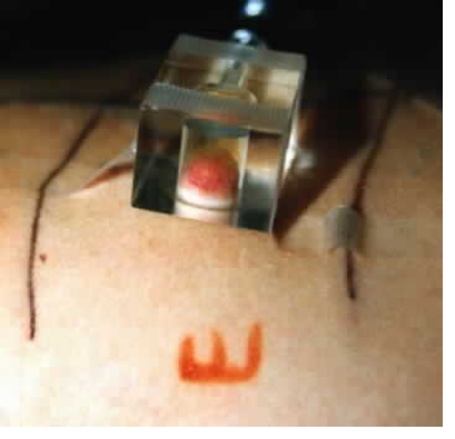
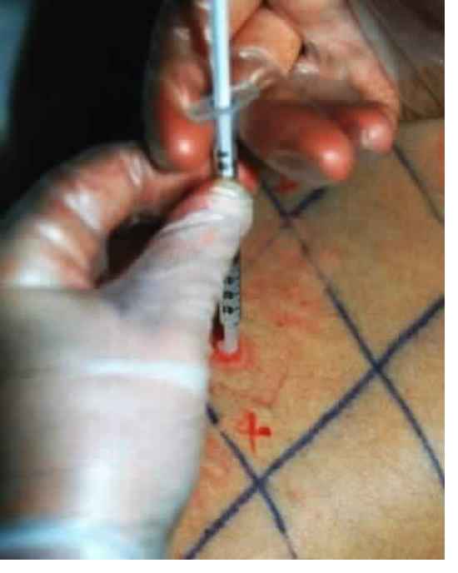
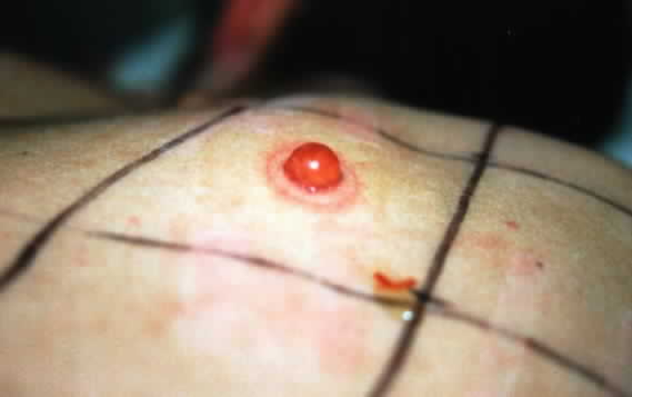
More complex designs
Latin Square
(Human’s back)
A | B | C | D
B | C | D | A
C | D | A | B
D | A | B | C
A,B,C & D are 4 wound healing treatments
Notes:
Although the Latin Square was invented with agricultural applications in mind – just like the one just discussed –it can be (& has been) applied in completely different experimental situations.
The objective is to find a treatment that can speed up the healing process
But need to test on “healthy volunteers”, i.e. people without wounds,
so we have to give them wounds that can heal …
… deroofed Blisters: Form Blister: Deroof - take off the top: Apply compound to the wound
Believe it or not, people volunteer to take part in these experiments!
Often students who want to subsidise their University grants – so be warned!
The skin differs in thickness, and other qualities, depending upon how close it is to the spine and the neck
The Latin square is useful for similar reasons to those discussed for the Farmer’s field with a stream and woods

Slide 15
Factorial Designs
From AQA GCSE Biology Specification
  “A fair test is one in which only the independent variable (thing you vary) affects the dependent variable (thing you measure), as all other variables are kept the same.”
This is often interpreted as meaning:
  It is good scientific practice only to vary one variable at a time in an experiment.
Wrong!
Wrong!
Wrong!
Notes:
I quote from AQA, but believe you are likely to see similar text in other examination board specifications.
Tell me – have you been taught this in your science lessons?
BUILD WRONGS!
To be fair to AQA, if you re-read the text, the interpretation below is not implied. It is only referring to experiments in which only one independent variable is being studied, it does not say anything about those cases when you want to study more than one variable at the same time. It is in these more complicated cases when the science of statistics has had a huge influence.
But first let me show why it is wrong – bad science – to only vary one variable at a time.

Slide 16
Factorial .v. 1-at-a-time
Detecting interactions
Coffee Sweetness Experiment
Two factors identified:
adding sugar
stirring
Notes:
Suppose we were completely ignorant of what caused a cup of coffee to taste sweet. Let’s see what might happen if we used the 1-at-a-time approach to experimentation.

Slide 17
Factorial .v. 1-at-a-time
Detecting interactions
Coffee Sweetness Experiment
Sweetness
Not stirred
No sugar
Sugar added
Notes:
1st experimental run: no sugar & not stirred = not sweet

Slide 18
Factorial .v. 1-at-a-time
Detecting interactions
Coffee Sweetness Experiment
Stirred
Stirring has
no effect !
Sweetness
Not stirred
No sugar
Sugar added
Notes:
2nd experimental run: no sugar & stirred = not sweet
Conclusion: stirring has no effect
We can drop the stirring factor from future runs.

Slide 19
Factorial .v. 1-at-a-time
Detecting interactions
Coffee Sweetness Experiment
Sugar has
no effect !
Sweetness
Not stirred
No sugar
Sugar added
Notes:
3rd experimental run: sugar added (& not stirred) = not sweet
Conclusion: sugar has no effect either (must be a placebo effect!)
Why does the 1-at-a-time strategy not work?

Slide 20
Factorial .v. 1-at-a-time
Detecting interactions
Coffee Sweetness Experiment
Stirred
Stirring & sugar
interact.
Sweetness
Not stirred
No sugar
Sugar added
Notes:
Why does the 1-at-a-time strategy not work?
There is a strong interaction between the 2 factors.
Although this is a ridiculously trivial experiment, when running real experiments with many factors that are not as well understood as in this example there are many more opportunities for interactions to occur.

Slide 21
Some Simple Factorial Designs
2 factors varied together, but in a planned manner
Drink | Sugar | Stir
1 | No | No
2 | No | Yes
3 | Yes | No
4 | Yes | Yes
The design can be represented by the vertices of a square.
Yes
(2)
(4)
Stir
(1)
(3)
No
No
Sugar
Yes
Notes:
This shows how this experiment would be designed so that the interaction would not be missed.
The simple pattern is clearly seen when the design is represented by the vertices of a square.

Slide 22
Some Simple Factorial Designs
A third factor could be added to the experiment
Drink | Milk | Sugar | Stir
1 | No | No | No
2 | No | No | Yes
3 | No | Yes | No
4 | No | Yes | Yes
5 | Yes | No | No
6 | Yes | No | Yes
7 | Yes | Yes | No
8 | Yes | Yes | Yes
The new design can be represented by the vertices of a cube.
Yes
Stir
Yes
Designs like these have had a huge impact on the development of new products.
Milk
No
No
No
Sugar
Yes
Notes:
This pattern is easily extended when we want to study more factors.
If we included the factor “Milk” in our coffee tasting study, the design could be represented by the vertices of a cube.
A problem with these designs is that each time a new variable is added, the size of the experiment doubles. However, statisticians have devised variants on this approach such that additional variables can be studied without increasing the size of the study …
For example, at Pfizer we have studied as many as 15 factors in only 20 experimental runs.

Slide 23
Making Modified Release Tablets
Protective layer
Functional Polymer
~1mm
Sugar core
Barrier layer
Drug layer
Notes:
A brief real example of how factorial designs are used.
Most tablets are designed to dissolve rapidly once swallowed, and release the active ingredient into the blood stream as quickly as possible.
Sometimes we want to delay the release of the active ingredient so that we can make the effect of taking a single dose last longer.
I wont try to explain the details of this diagram. It is sufficient to know that this particular medicine consists of a capsule that contain hundreds of small spheres, each one being made by starting with a very small sugar sphere and adding layers of other compounds on top to end up with a particle as illustrated by this diagram.
The various layers cause the drug to be released in a controlled manner, hence making the medicine last longer. It’s a bit like a “Gob Stopper” (does anyone remember these sweets?!) – although these tablets do not have to be sucked to death for hours at a time!

Slide 24
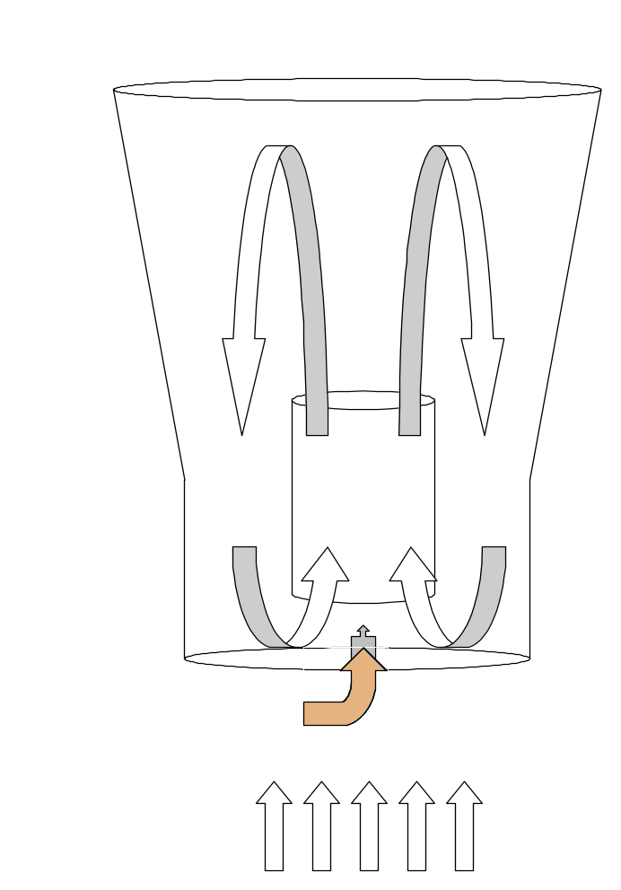
Fluid Bed Coating Process
Key parameters
Position of
Wurster Column
Temperature
Batch size
Airflow
Outlet Air
Product
Inlet Air
Spray gun
Spray rate
Atomising Air Pressure
Nozzle Size
Spray Pattern
Batch size
Core size/ shape
Spray rate
Air Flow
Notes:
These beads are made in a machine that works in a similar fashion to a candy floss machine. The particles are forced to flow around inside a chamber whilst the various compounds are sprayed onto them.
There are numerous variables that can be altered as indicated on this diagram, and the challenge is to find the settings for these variables that result in the best quality drug particles.
By using statistically designed experiments this process can be optimised in a fraction of the time, and money, it would take to do this in a conventional 1-variable-at-a-time manner. We also learn a lot more about the process by using a statistical approach as opposed to a less structured approach to experimentation.

Slide 25
Using Statistics to Design a Paper Plane
Plane | Nose “bulk up” | Wing Size | Wing Flap
1 | No | Standard | No
2 | No | Standard | Yes
3 | No | Short | No
4 | No | Short | Yes
5 | Yes | Standard | No
6 | Yes | Standard | Yes
7 | Yes | Short | No
8 | Yes | Short | Yes
Unfortunately, we haven’t time to do this as part of the lecture …
… but I have further details in case you can persuade your teacher to do this as part of your maths course!
Notes:
Hopefully I’ve shown how statistical ideas can be applied to a wide variety of application areas. In fact, you could even use these experimental designs to improve on the paper aeroplane [here’s one I developed using this technique] If you want to try this yourself I have instructions to get you started at the front.

Slide 26
Concluding Remarks
Experimental design is very important
  In every area where new knowledge is sought
Statisticians have specialist knowledge
  Methods that many scientists are unaware
Statistical approaches are transferable
  Across disparate application areas
As a result the work is very interesting
  Will get involved with science and problem solving and team working and creating stuff …

